Slide 1
WHAT IS THE STATISTICAL LIKELINESS OF SURVIVING A PLANE CRASH
IHO LÓPEZ TOBI

Slide 2
Problem Statement:
Airplanes have become one of the most popular ways of transportation for modern society. But how safe is it? Certainly a machine that is able to fly at thousands of miles above the ground and goes over 800 miles an hour will build a reputation for being dangerous, but is it?

Slide 3
Dataset:
The dataset contains 5269 entries of accidents recorded from the year 1908 to 2009

Slide 4
Tools:
R, Python, Jupyter notebook,Orange

Slide 5
Data processing:
·Clean data.
·Fill in missing values.
·Change the format for some of the columns.
·Remove irrelevant information.
Notes:
1.What are the different causes of Airplane crashes.
2. What are the most dangerous locations.
3.Which companies are the worse based on accidents recorded.
4.Which airplane type are the most dangerous.
5.How many accidents happen yearly
6.Which seasons are the most dangerous
7.What is the likeliness to Survive a Plane crash.

Slide 6
Findings:
1.What are the different causes of Airplane crashes.
2. What are the most dangerous locations.
3.Which companies are the worse based on accidents recorded.
4.Which airplane type are the most dangerous.
5.How many accidents happen yearly
6.Which seasons are the most dangerous
7.What is the likeliness to Survive a Plane crash.

Slide 7
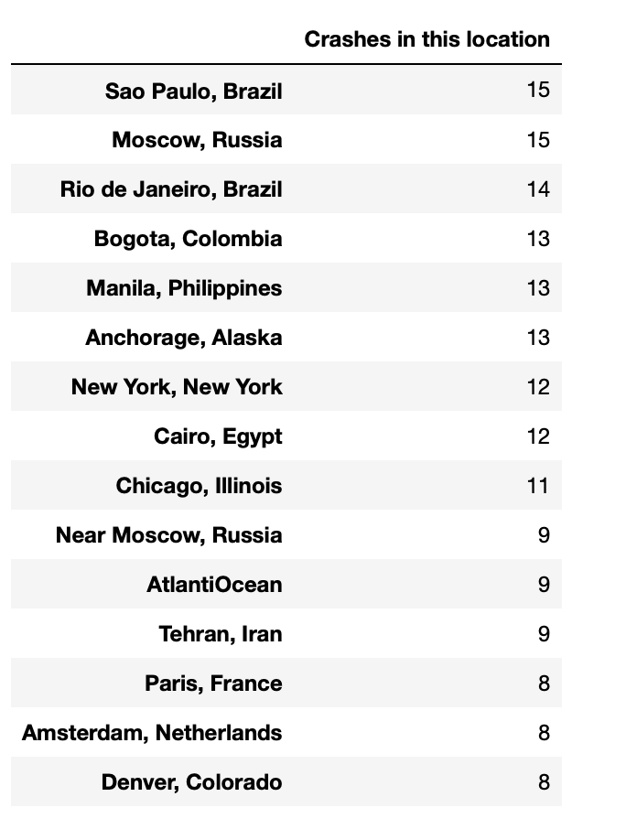
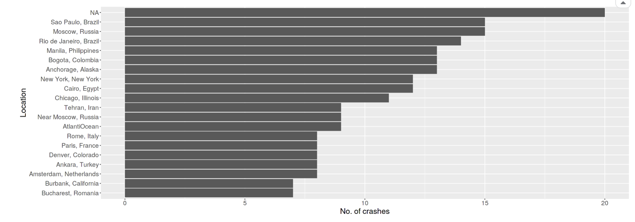
Figure 1.
Figure 2.
Note. This graph shows the locations with most accidents reported. N/A means that the location of the accident could not be reported or the crash did not occur in land.
Note. This table shows the locations with the most amount of crashes reported listed in descending order with a minimal threshold of 8 crashes per location.

Slide 8
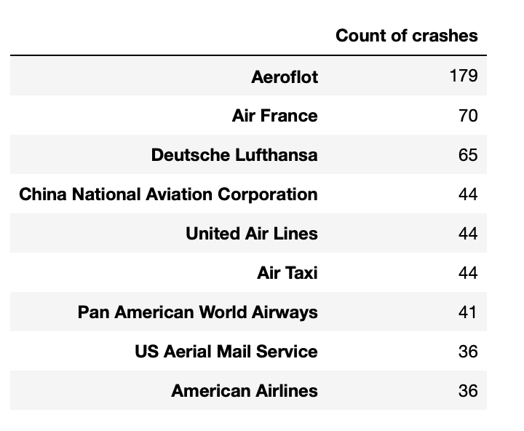
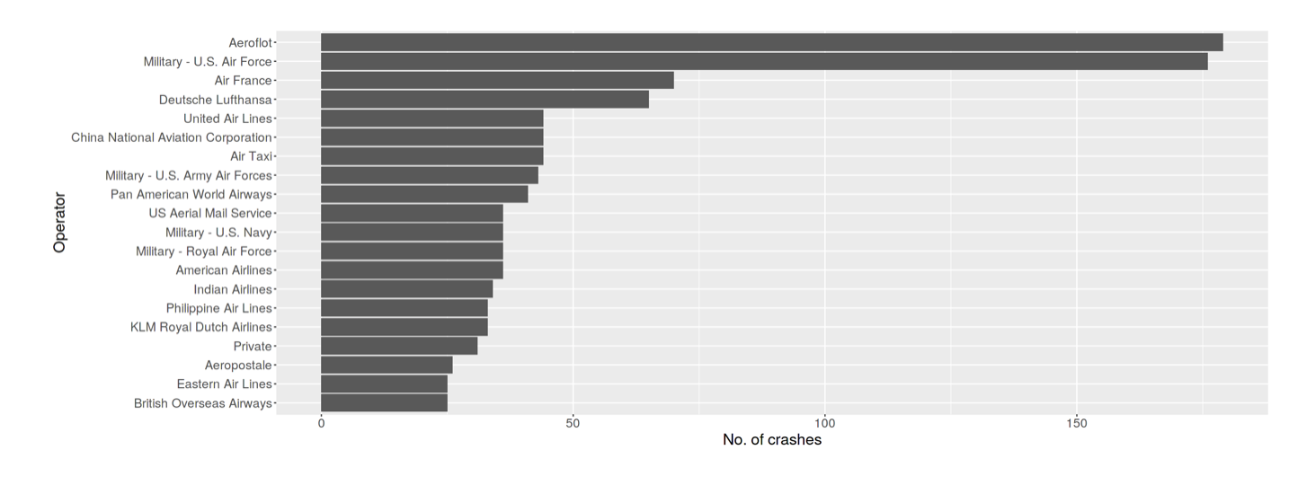
Figure 3.
Figure 4.
Note. This graph shows the airlines with most accidents recorded including non-passenger planes such as the US Military for reference.
Note. This table shows the airlines with the most amount of crashes recorded in descending order with a minimal threshold of 36 crashes.

Slide 9
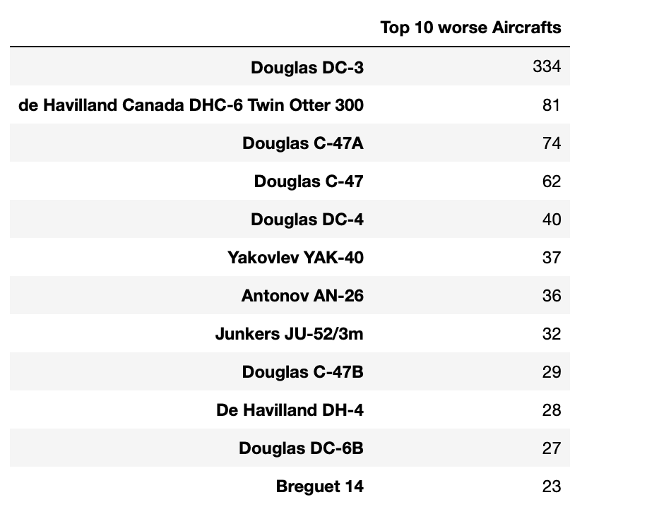
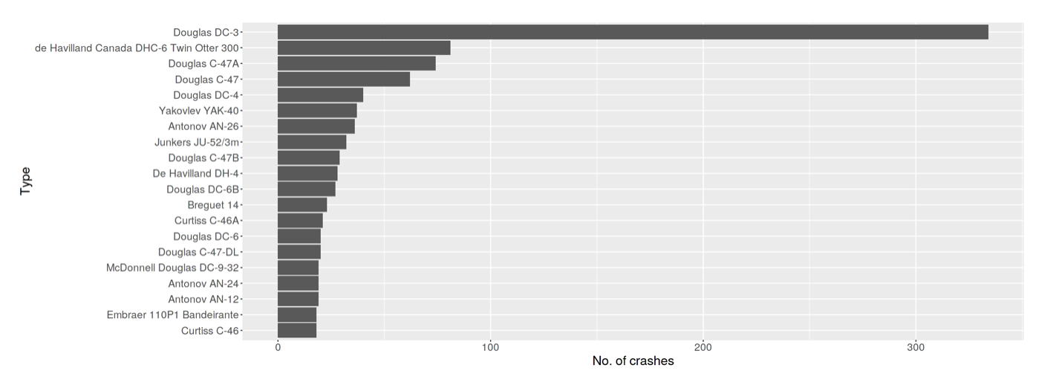
Figure 5.
Figure 6.
Note. This graph shows the Aircraft type with most accidents. With the threshold extended from 23 to 15.
Note. This table shows the different Aircraft types with the most amount of crashes recorded listed in descending order with a minimal threshold of 23 crashes.

Slide 10
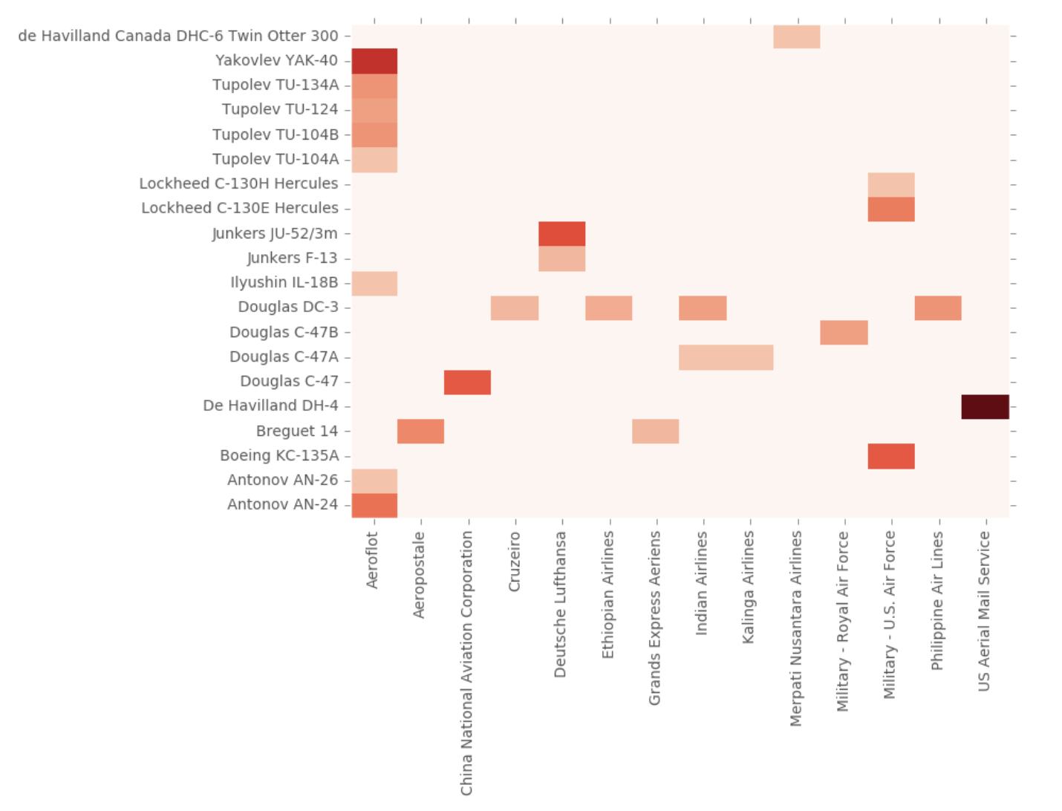
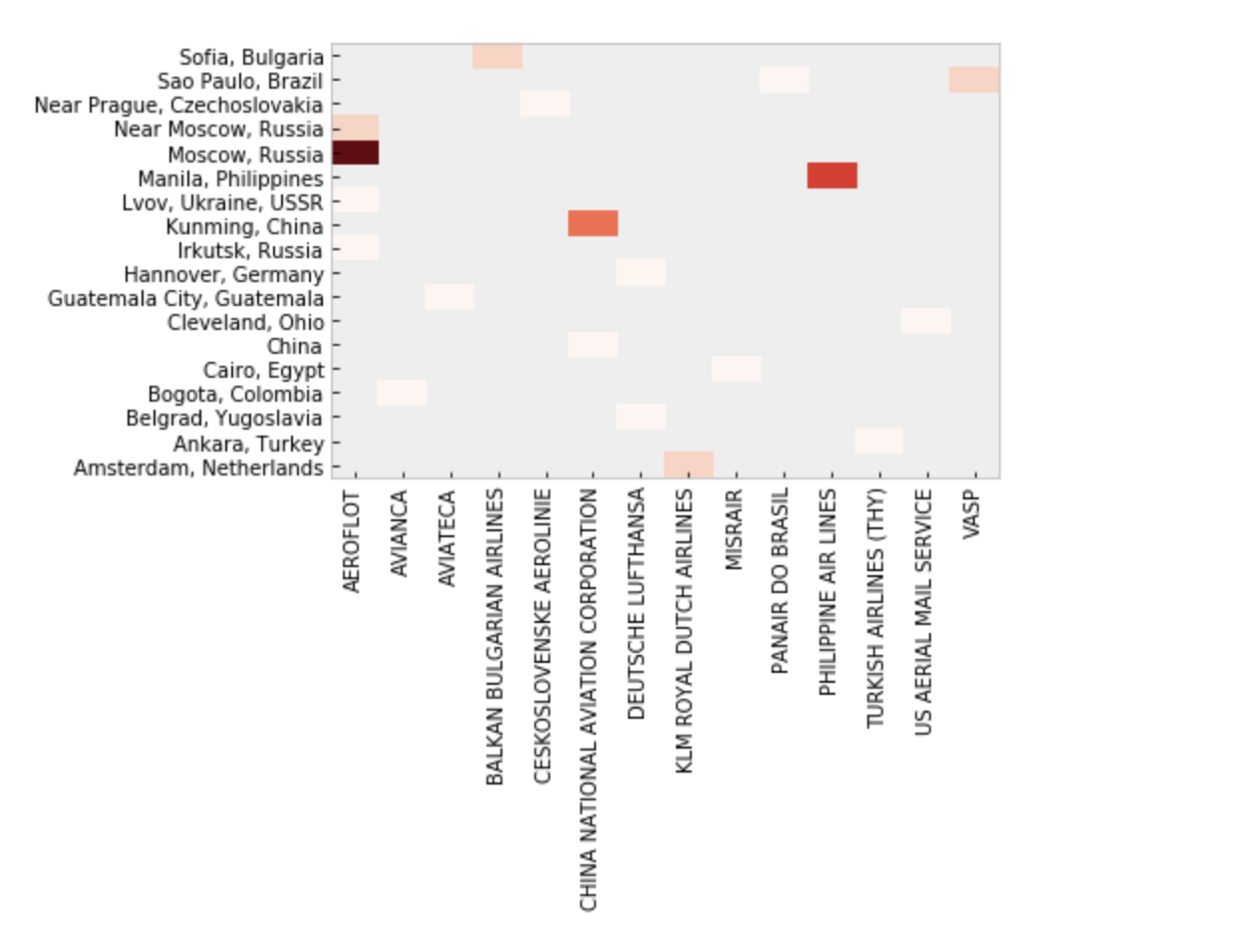
Figure 7.
Figure 8.
Note. Figure 7 & 8 are heat maps that show which airlines have crashed which type of aircraft and the locations of the accidents. The darker the color the more incidents recorded by the airline with the certain type of plane at a certain location respectively.

Slide 11
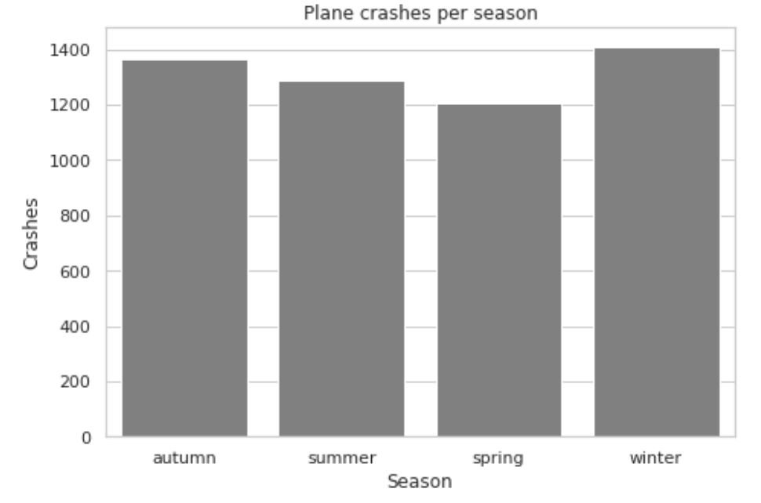
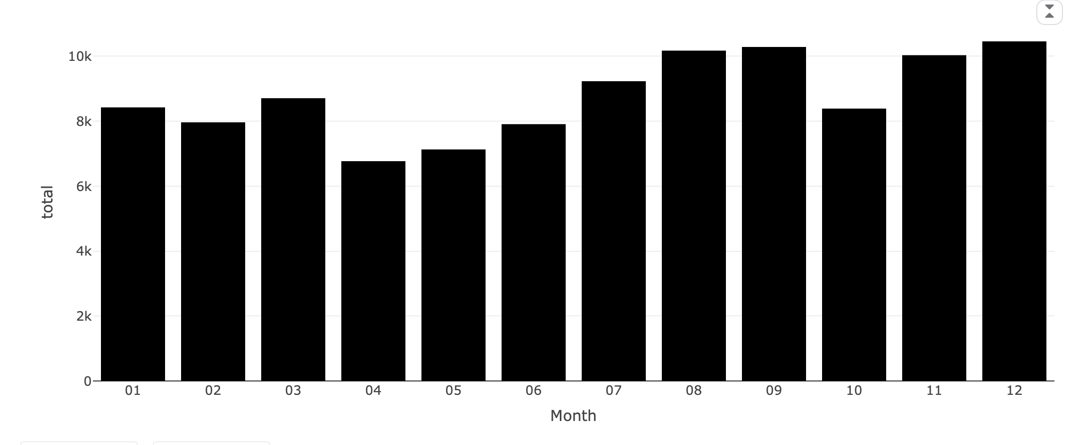
Figure 9.
Figure 10.
Note. This graph shows the months where different accidents have been reported.
Note. This graph shows the seasons where accidents were reported.
·Spring: Months 3 to 5
·Summer: Months 6-8
·Autumn : Months 9-11
·Winter : Months 12-2

Slide 12
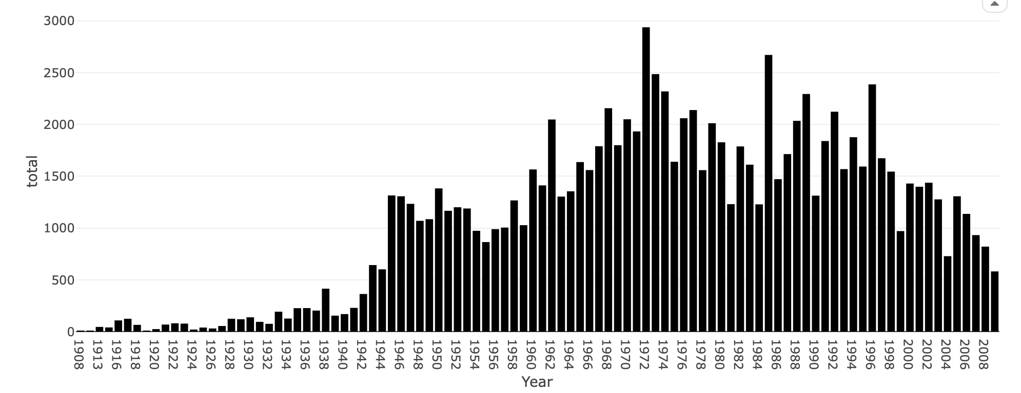
Figure 11.
Note. This graph shows the amount of accidents recorded yearly from the year 1908 to 2008.

Slide 13
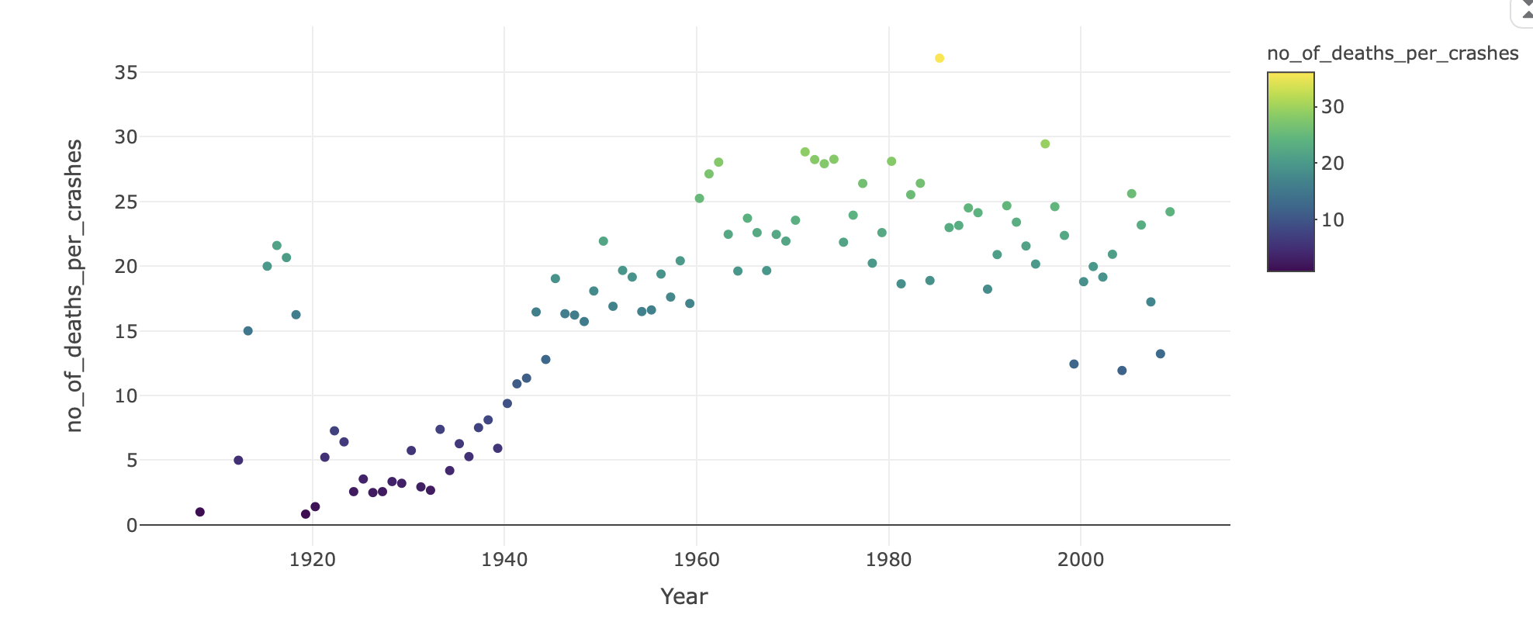
Figure 12.
Note. This graph shows the amount of victims recorded yearly from the year 1908 to 2008.

Slide 14
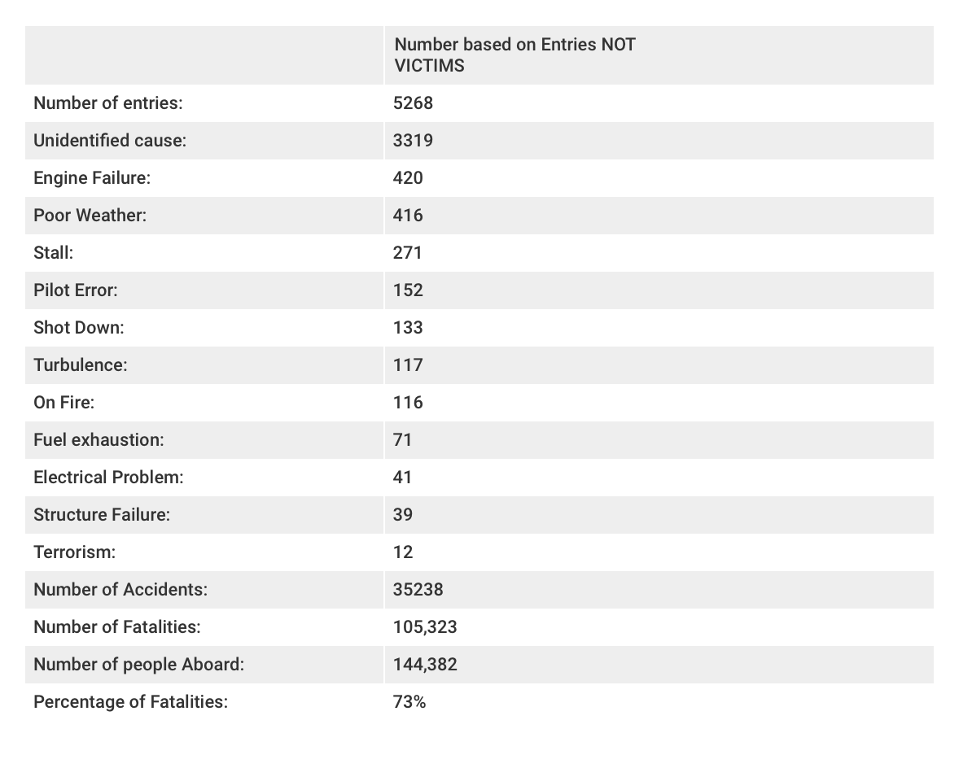
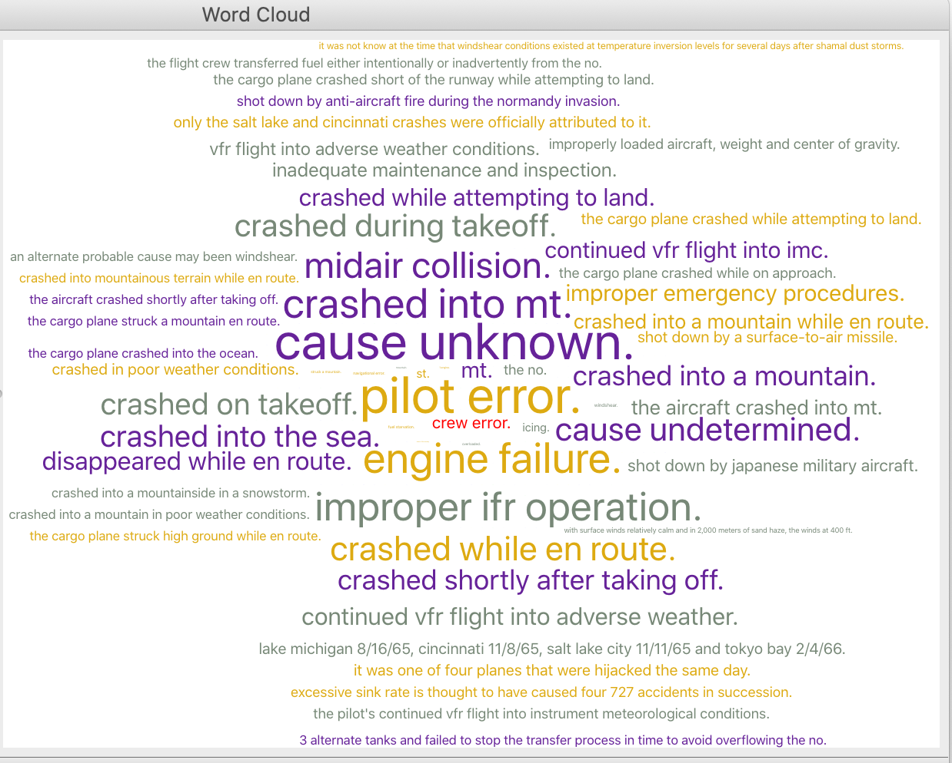
Figure 13.
Figure 14.
Note. Figure 13 & 14 show the different reasons thought to be the causes of accidents reported.

Slide 15
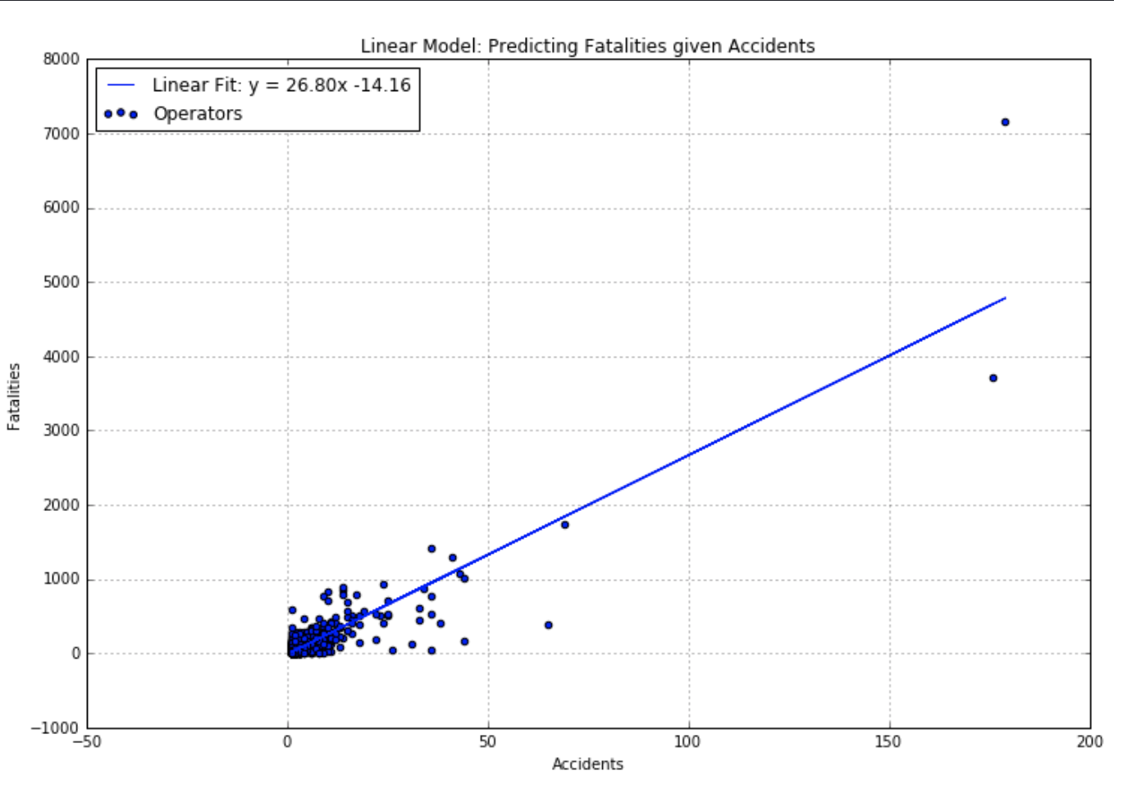
Figure 15.
Note. Figure 15 shows a linear regression model predicting how many fatalities an accident would produce.

Slide 16
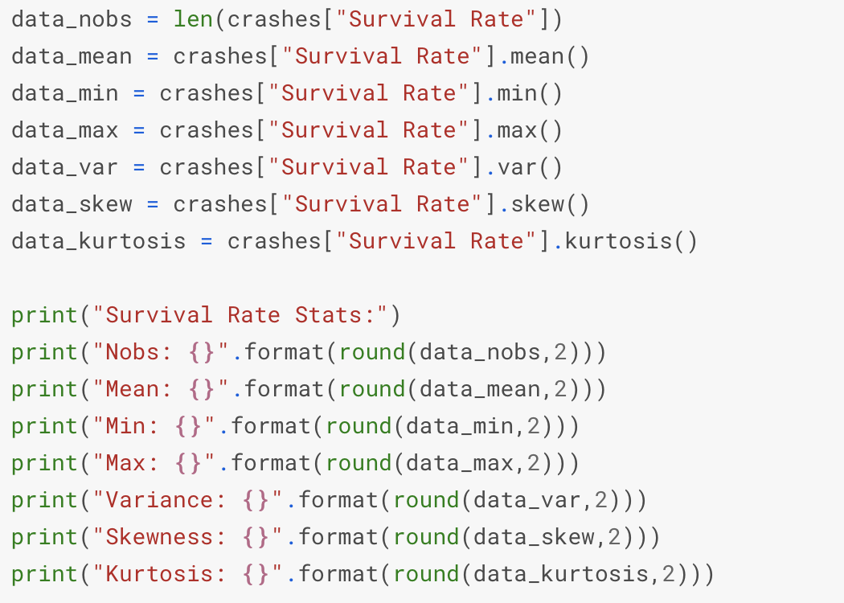
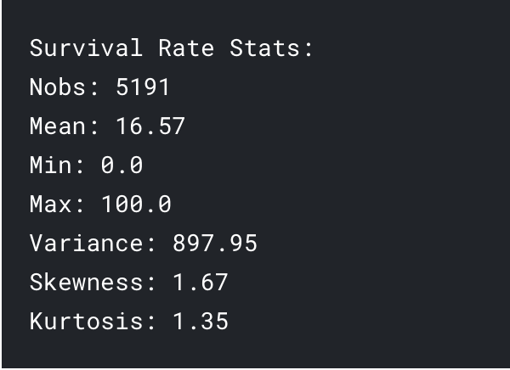
Figure 16.
Note. Figure 16 shows the different survival rate statistics.

Slide 17
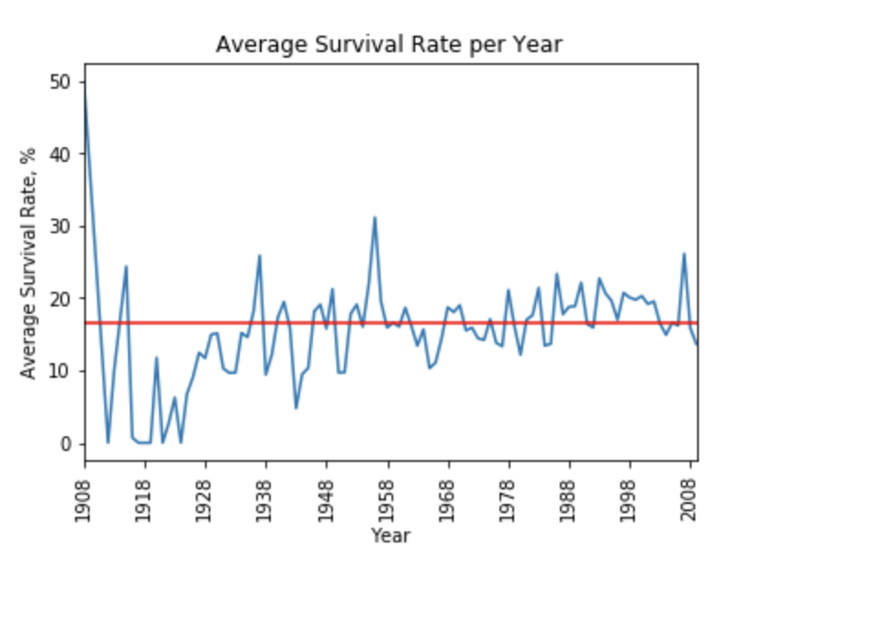
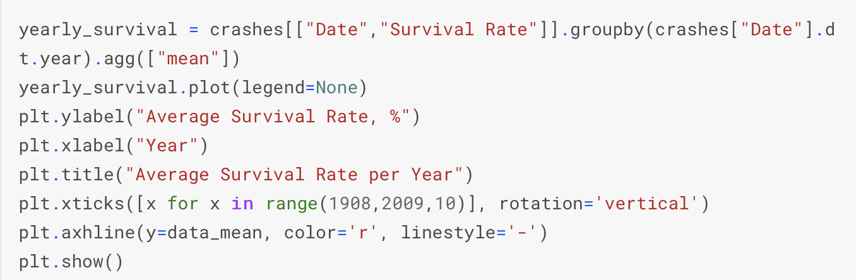

Figure 17.
Note. Figure 17 shows the different average survival rate per year.

Slide 18
Conclusion:
The likeliness of dying in a plane crash is of 1 in 11 million

